Slide 1
GRAPHS
BHAVANA
DAY 21
02/05/2024

Slide 2
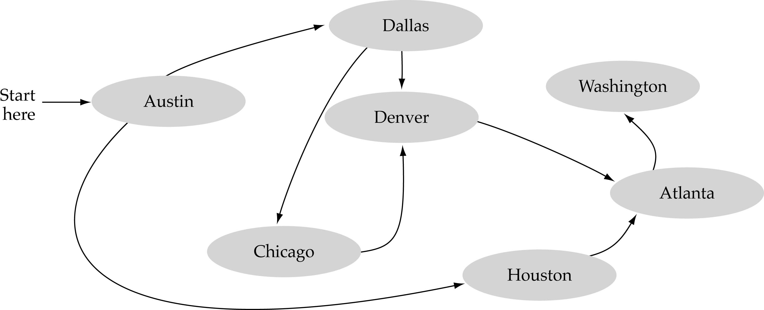
What is a graph?
A data structure that consists of a set of nodes (vertices) and a set of edges that relate the nodes to each other
The set of edges describes relationships among the vertices

Slide 3
Formal definition of graphs
A graph G is defined as follows:
G=(V,E)
V(G): a finite, nonempty set of vertices
E(G): a set of edges (pairs of vertices)

Slide 4
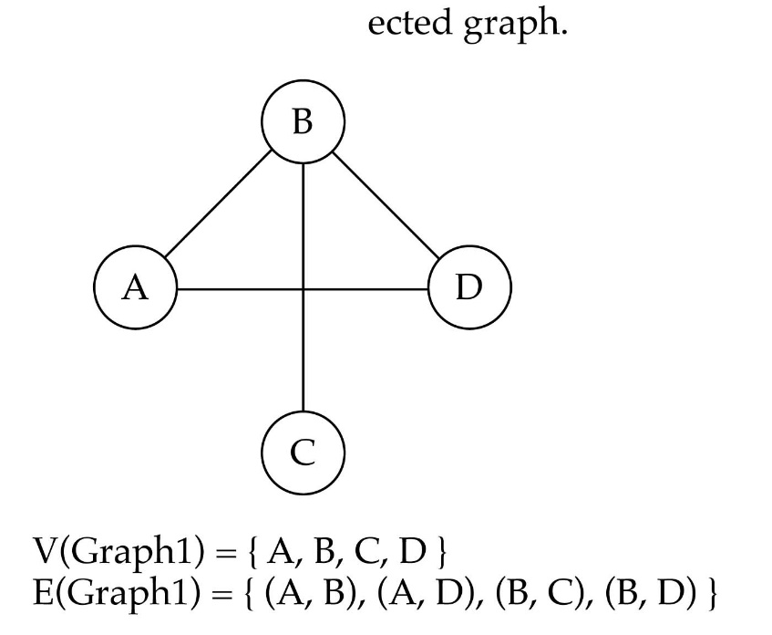
Directed vs. undirected graphs
When the edges in a graph have no direction, the graph is called undirected

Slide 5

Directed vs. undirected graphs
When the edges in a graph have a direction, the graph is called directed (or digraph)
E(Graph2) = {(1,3) (3,1) (5,9) (9,11) (5,7)

Slide 6

Graph terminology
Adjacent nodes: two nodes are adjacent if they are connected by an edge
Path: a sequence of vertices that connect two nodes in a graph
Complete graph: a graph in which every vertex is directly connected to every other vertex
5 is adjacent to 7
7 is adjacent from 5

Slide 7
What is the number of edges in a complete directed graph with N vertices?
N * (N-1)
What is the number of edges in a complete undirected graph with N vertices?
N * (N-1) / 2
Weighted graph: a graph in which each edge carries a value
Array-based implementation
A 1D array is used to represent the vertices
A 2D array (adjacency matrix) is used to represent the edges

Slide 8
Depth-First-Search (DFS)
What is the idea behind DFS?
Travel as far as you can down a path
Back up as little as possible when you reach a "dead end" (i.e., next vertex has been "marked" or there is no next vertex)
DFS can be implemented efficiently using a stack

Slide 9
Breadth-First-Searching (BFS)
What is the idea behind BFS?
Look at all possible paths at the same depth before you go at a deeper level
Back up as far as possible when you reach a "dead end" (i.e., next vertex has been "marked" or there is no next vertex)

Slide 10


